Slide 1
Health Information System
Approach, Design, and Solution – by Sheila Ngetich

Slide 2
Introduction
Objective: The aim of the Health Information System (HIS) is to streamline patient record management, program enrollments, and provide easy access to patient data.
Scope: Patient management, program management, enrollment tracking, and providing RESTful APIs for interaction.

Slide 3
Approach
Backend Technology: Node.js with Express.js to build a RESTful API.
Database: MySQL for relational data management (patients, programs, enrollments).
Testing: Mocha and Chai for unit and API testing.
Deployment: Local environment setup (localhost) using Node.js server.

Slide 4
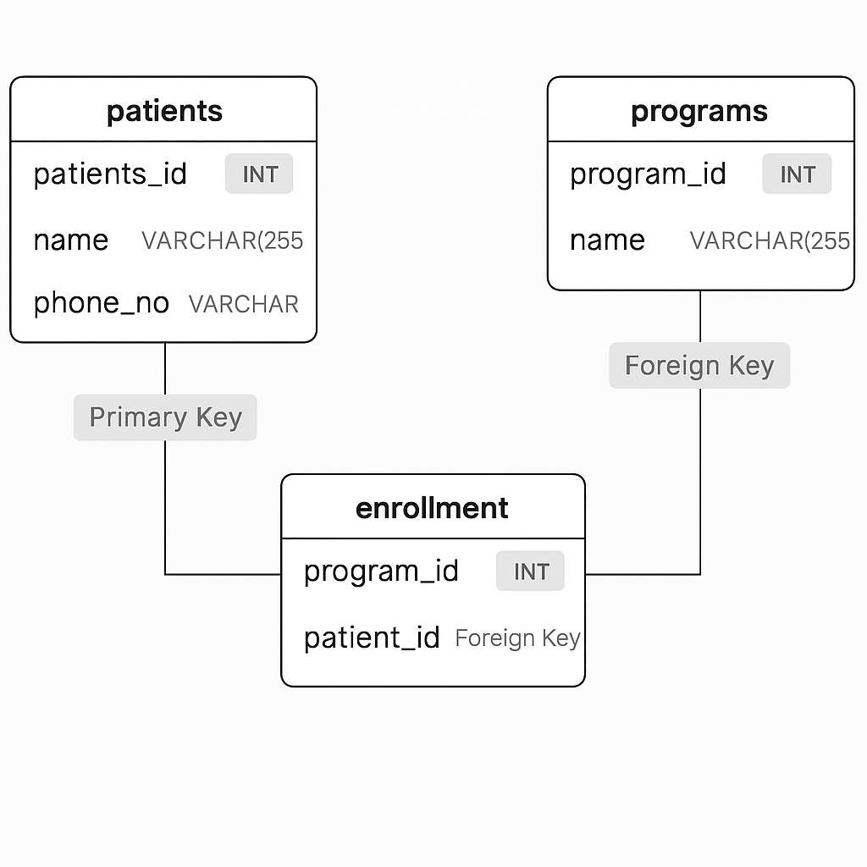
System Design
Tables: patients, programs, enrollmentRelationships:
One-to-many relationship between patients and enrollments, many-to-many relationship between patients and programs.

Slide 5
Solution
Features:
Patient data management (Add, Update, Delete, Fetch)
Program enrollment management (Enroll, View Enrollments)
Fetch patient details and the programs they are enrolled in.
Technology Stack:
Backend: Node.js, Express.js
Database: MySQLTesting
Framework: Mocha, ChaiVersion
Control: Git, GitHub

Slide 6
API Endpoints
List of Key API Endpoints:
GET /patients/:id – Retrieve patient details
POST /patients – Add new patient
POST /enrollment – Enroll patient into a program
GET /programs – Retrieve all programs

Slide 7
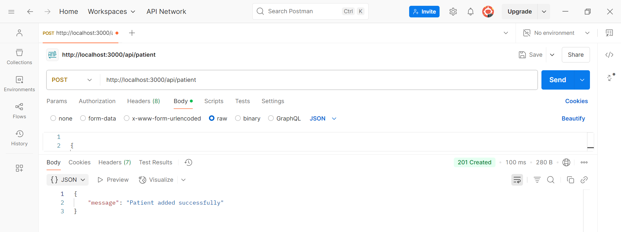
Prototype Demonstration

Slide 8
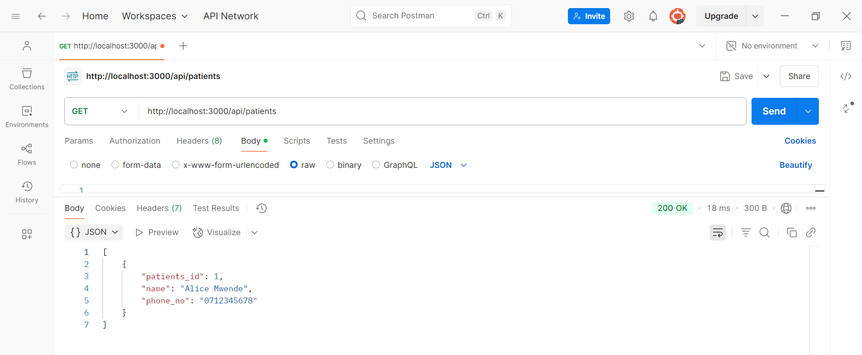

Slide 9
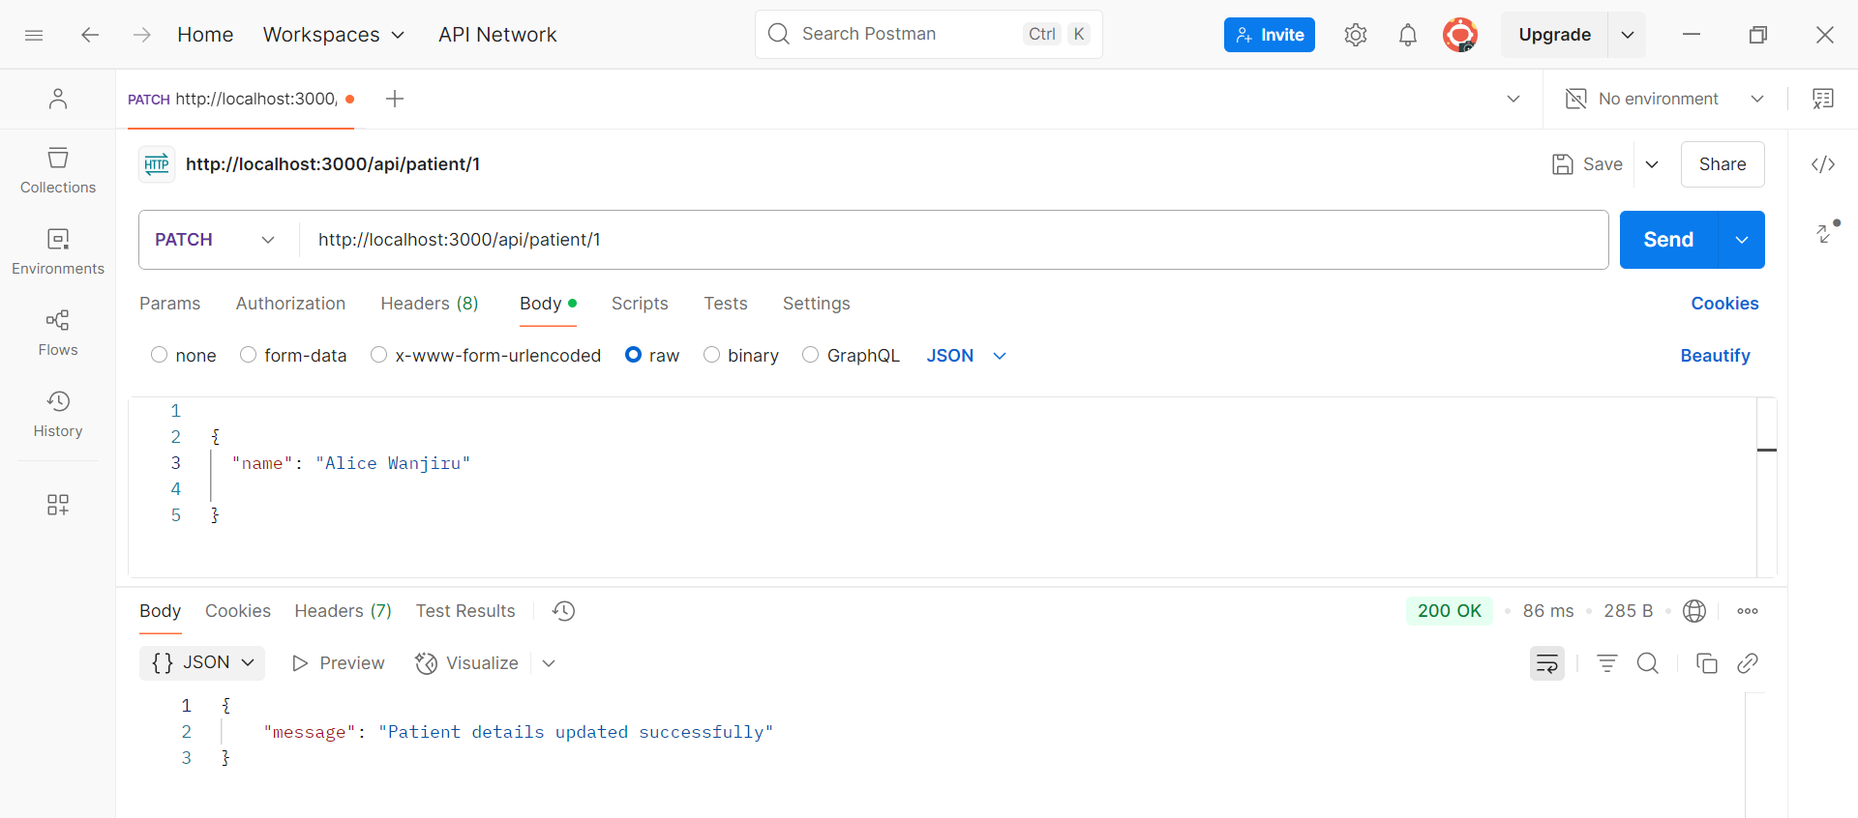

Slide 10
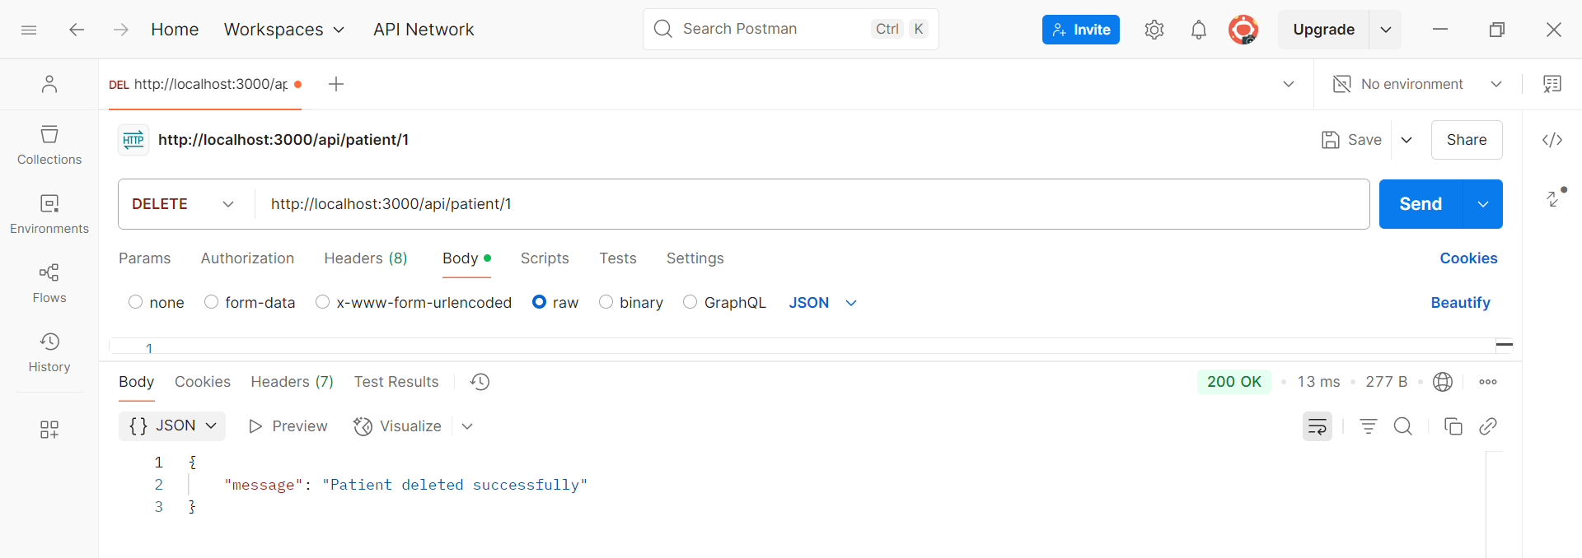

Slide 11
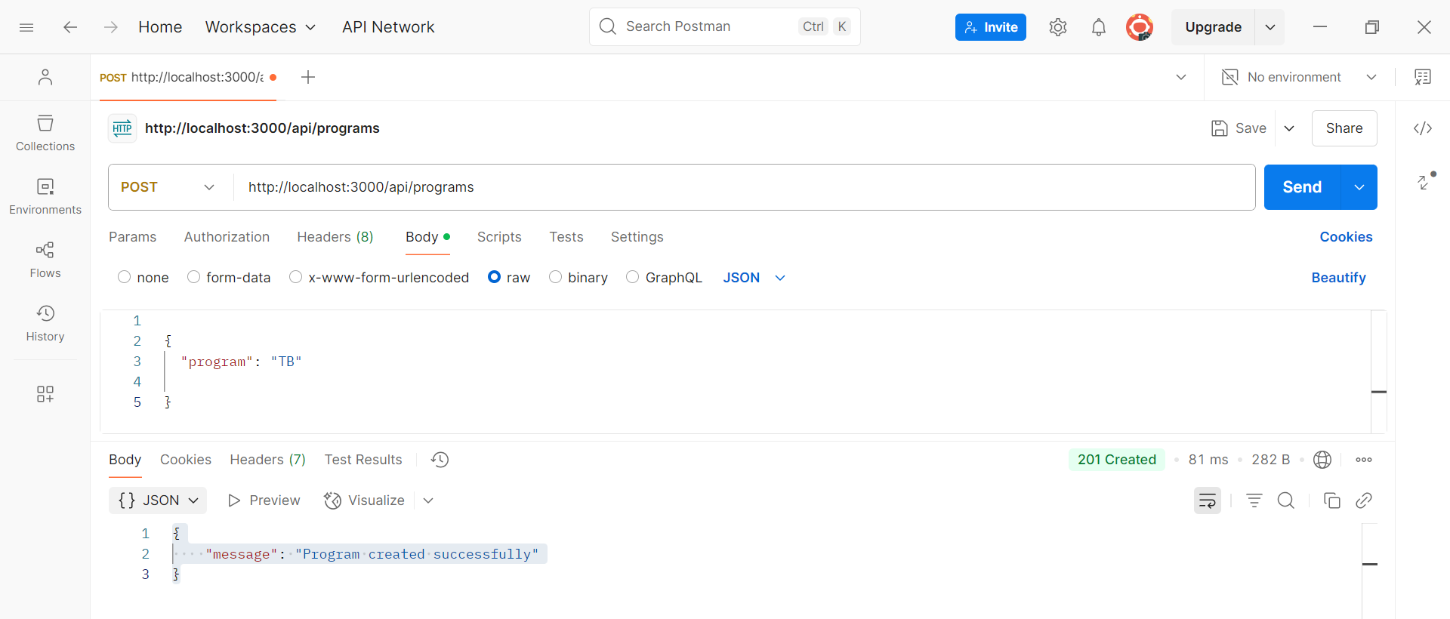

Slide 12
